Slide 1


DATATECH LABS.
Data Engineering Course.
Week 4: Advanced Data Processing with Spark and Streaming Pipelines

Slide 2
Outline: Week 4
Advanced Spark Programming
Spark RDDs, DataFrames, and Datasets
Spark SQL and analytics
Machine learning with Spark MLlib
Streaming Data Processing
Introduction to stream processing concepts
Apache Kafka for real-time data ingestion
Stream processing with Apache Flink
DATATECH LABS.

Slide 3
Advanced Spark Programming
DATATECH LABS.

Slide 4
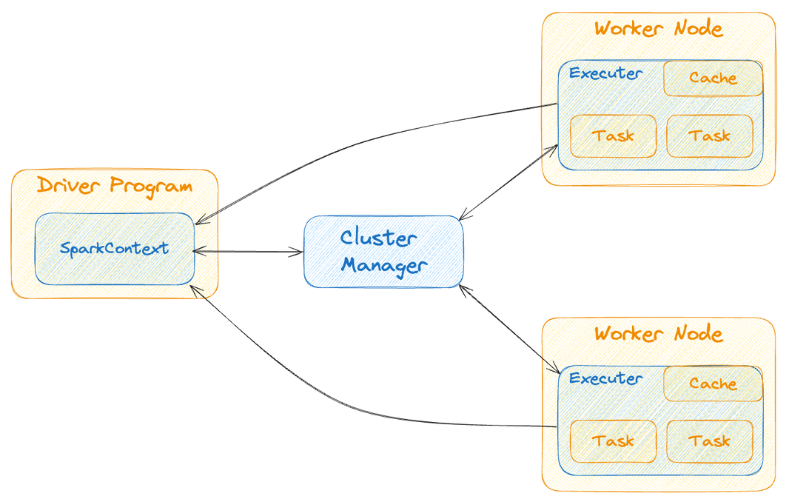
Spark Architecture (Recap)
Driver Program: The process running the main() function of the application and creating the SparkContext.
Cluster Manager: is responsible for allocating resources and managing the cluster on which the Spark application runs.
Worker Nodes: The slave nodes where the executors run.
Executors:
Are worker processes responsible for executing tasks.
Are launched on worker nodes and communicate with the driver program and cluster manager.
Run tasks concurrently and store data in memory or disk for caching and intermediate storage.
DATATECH LABS.

Slide 5
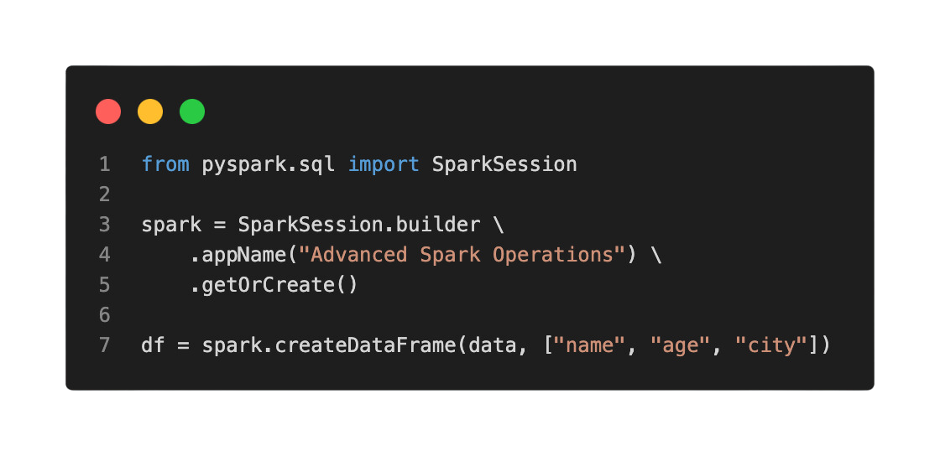
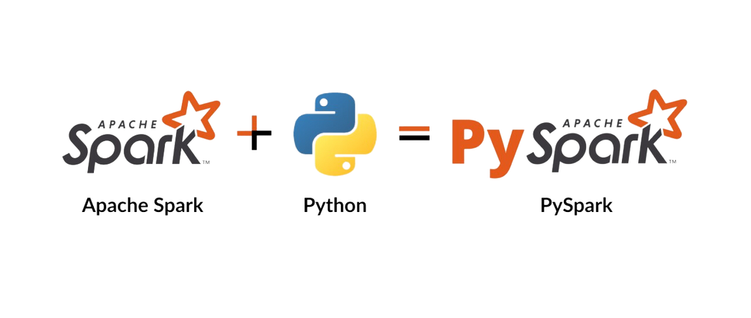
Spark Architecture (Recap)
Creating Spark Session.
Key features:
In-memory computation
Fault tolerance
Lazy evaluation
Support for multiple languages:
Spark: Scala, Java
PySpark: Python
SparkR: R
DATATECH LABS.

Slide 6
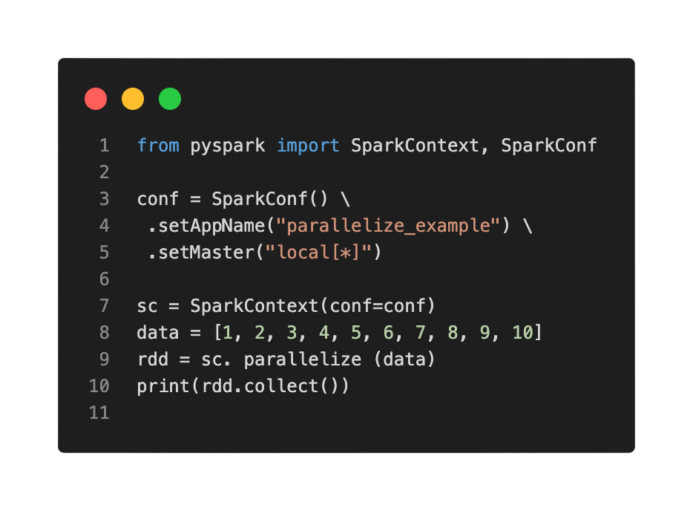
Spark RDDs (Resilient Distributed Datasets)
Definition: Fundamental data structure of Spark
Essentially refers to a distributed collection of data records
Resilience Advantage is their fault-tolerant nature
Properties:
Immutable
Partitioned
Ability to be operated on in parallel
DATATECH LABS.

Slide 7
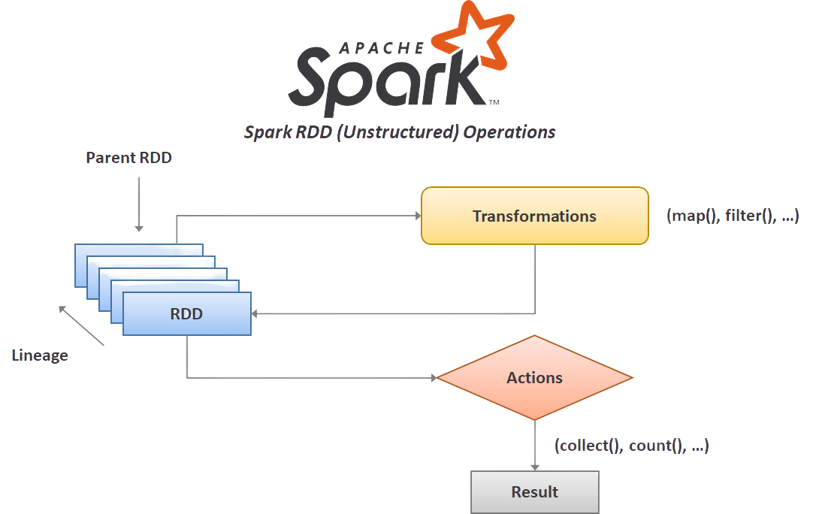
RDD Operations
Transformations (lazy operations):
map, flatMap, filter, distinct, sample
Actions (trigger execution):
collect, count, first, take, reduce
DATATECH LABS.

Slide 8
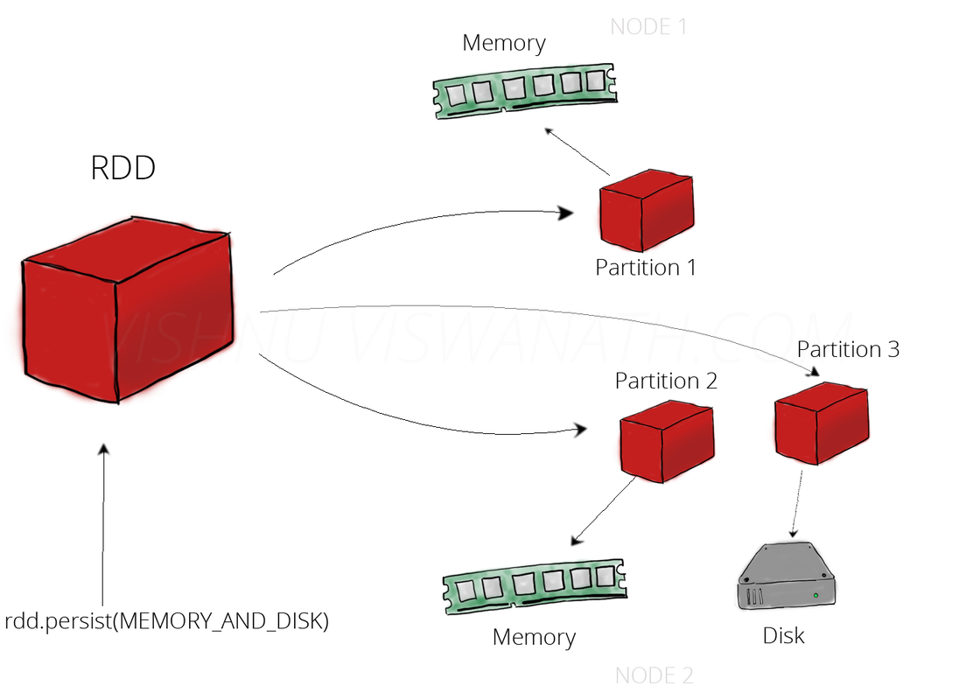
RDD Persistence
cache() and persist() methods
Storage levels:
MEMORY_ONLY
MEMORY_AND_DISK
DISK_ONLY
OFF_HEAP
DATATECH LABS.

Slide 9
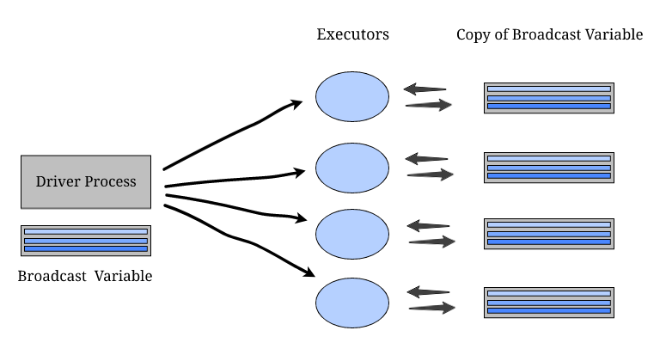
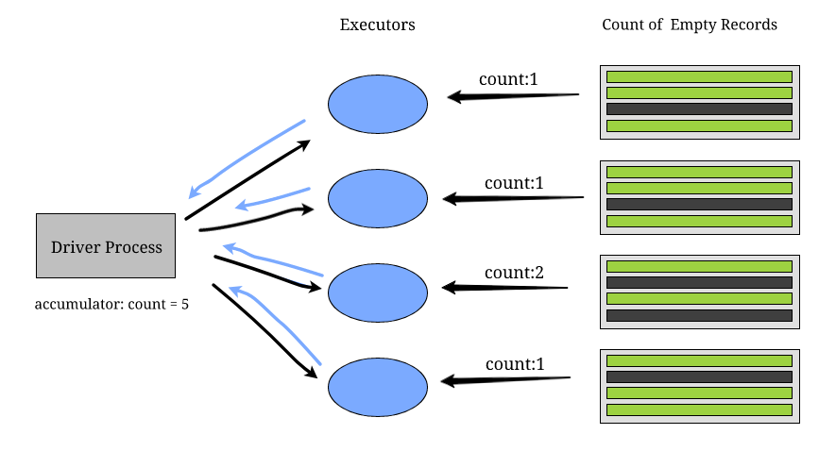
Shared Variables in Spark
Broadcast variables
Read-only variables cached on each machine.
Accumulators
Variables that are only "added" to through an associative and commutative operation.
DATATECH LABS.

Slide 10
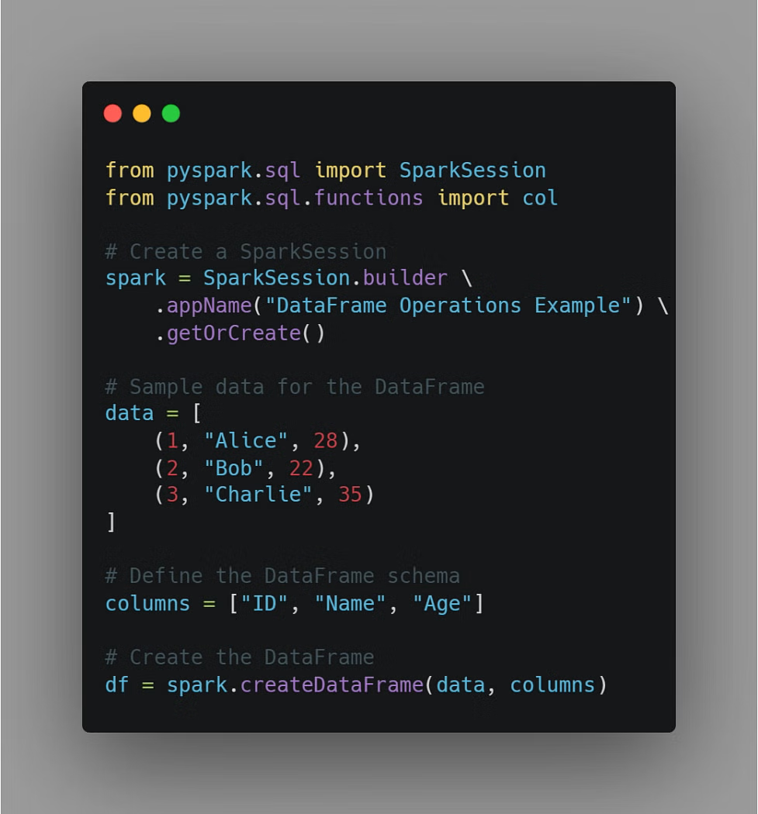
Spark DataFrames
Definition: Distributed collection of data organized into named columns
Advantages of DataFrames over RDDs:
Named columns
Optimized execution
SQL-like operations
DATATECH LABS.

Slide 11
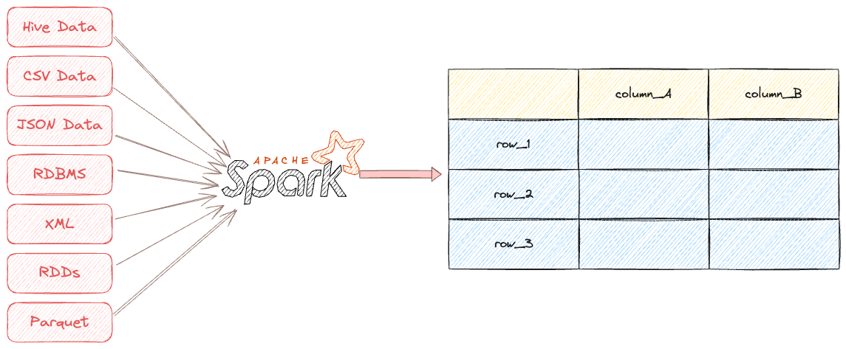
Creating DataFrames
From RDDs
From a list of data
Reading from files (CSV, JSON, Parquet)
From Hive tables
DATATECH LABS.

Slide 12
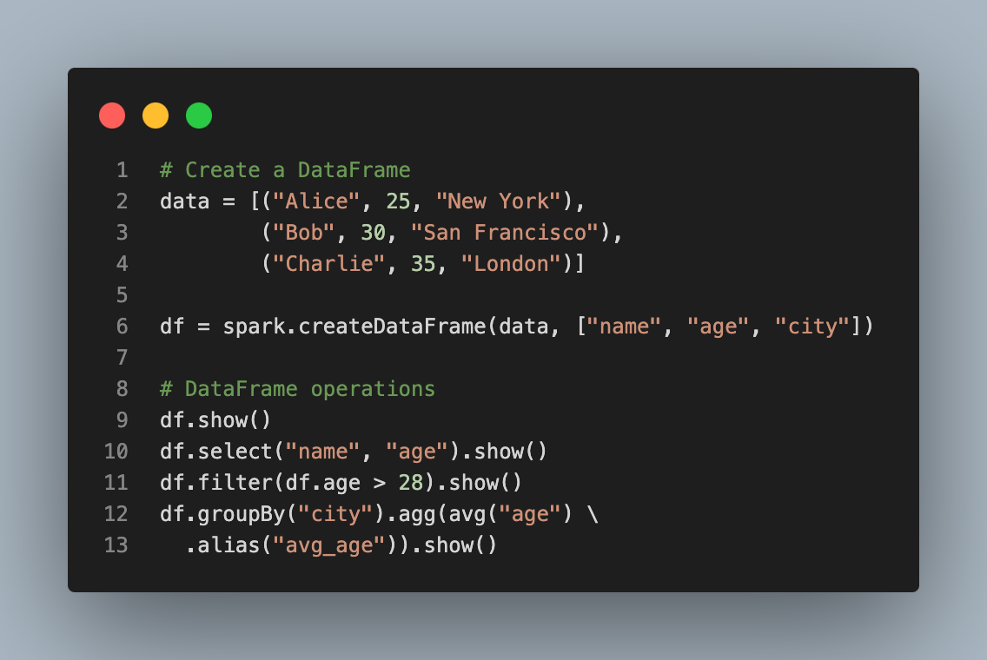
Spark DataFrame Operations
select(), filter(), groupBy()
join(), union(), orderBy()
withColumn(), drop()
agg() for aggregations
DATATECH LABS.

Slide 13
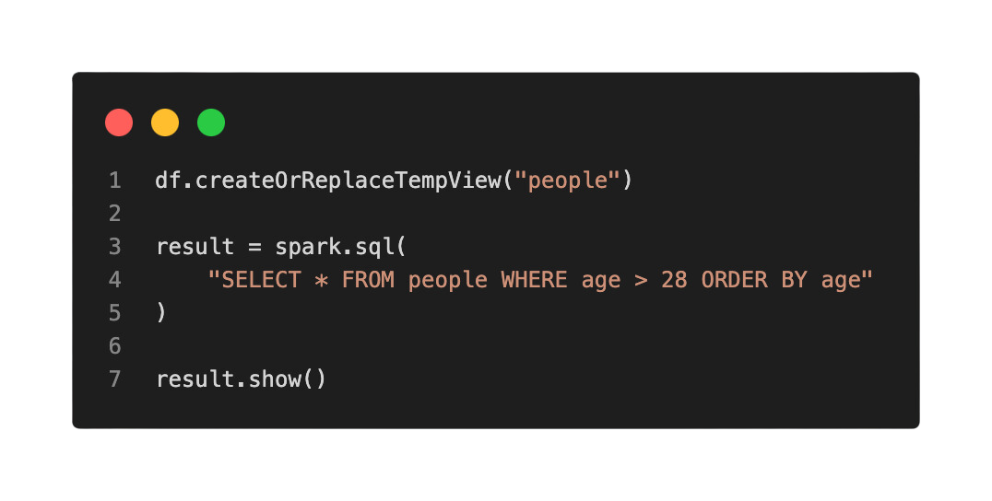
Spark SQL
Running SQL queries on DataFrames
Creating temporary views
Catalog API for managing tables and databases
DATATECH LABS.

Slide 14
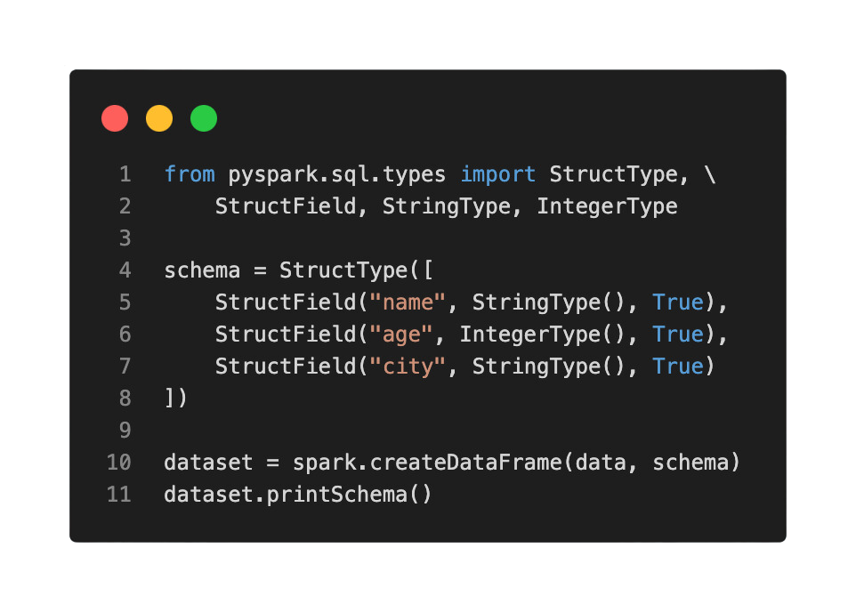
Spark Datasets
Definition: Strongly-typed version of DataFrames
Benefits:
Type-safety
Lambda functions in queries
DATATECH LABS.

Slide 15
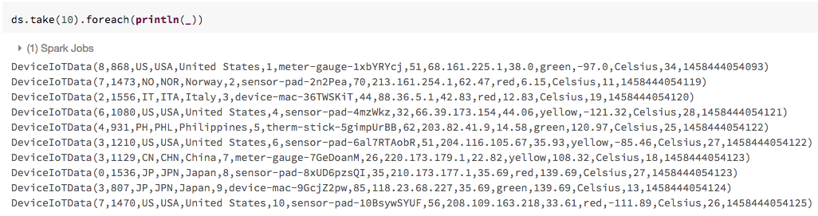
Working with Datasets
Creating Datasets
Dataset operations
Converting between DataFrames and Datasets
DATATECH LABS.

Slide 16
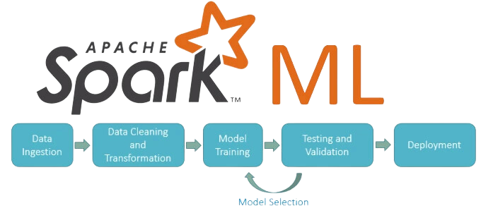
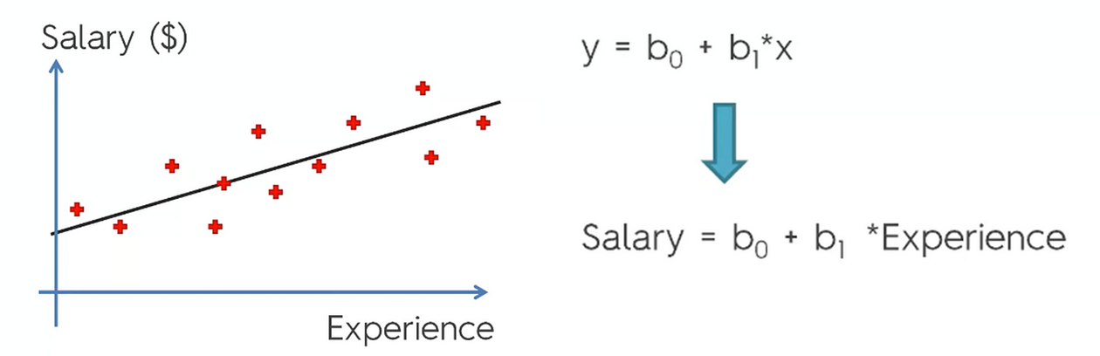
Machine Learning with Spark MLlib
MLlib: is Spark's machine learning (ML) library. Its goal is to make practical machine learning scalable and easy
Supported algorithms:
Classification
Regression
Clustering
Collaborative filtering
DATATECH LABS.

Slide 17
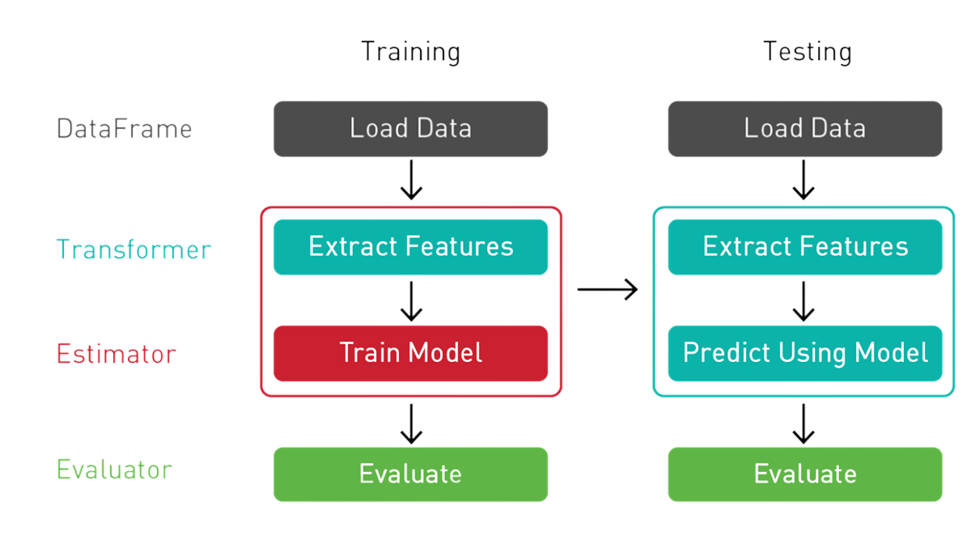
MLlib Pipeline APIs
Transformers
Estimators
Parameters
Pipeline composition
DATATECH LABS.

Slide 18
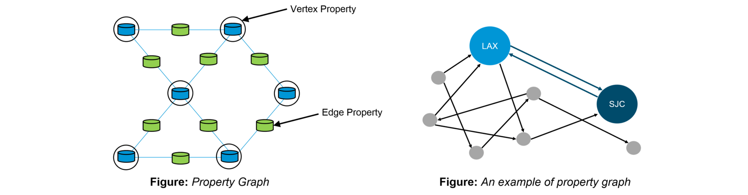
GraphX for Graph Computation
Overview of GraphX
Key abstractions: Graph, VertexRDD, EdgeRDD
Graph operators and algorithms
DATATECH LABS.

Slide 19
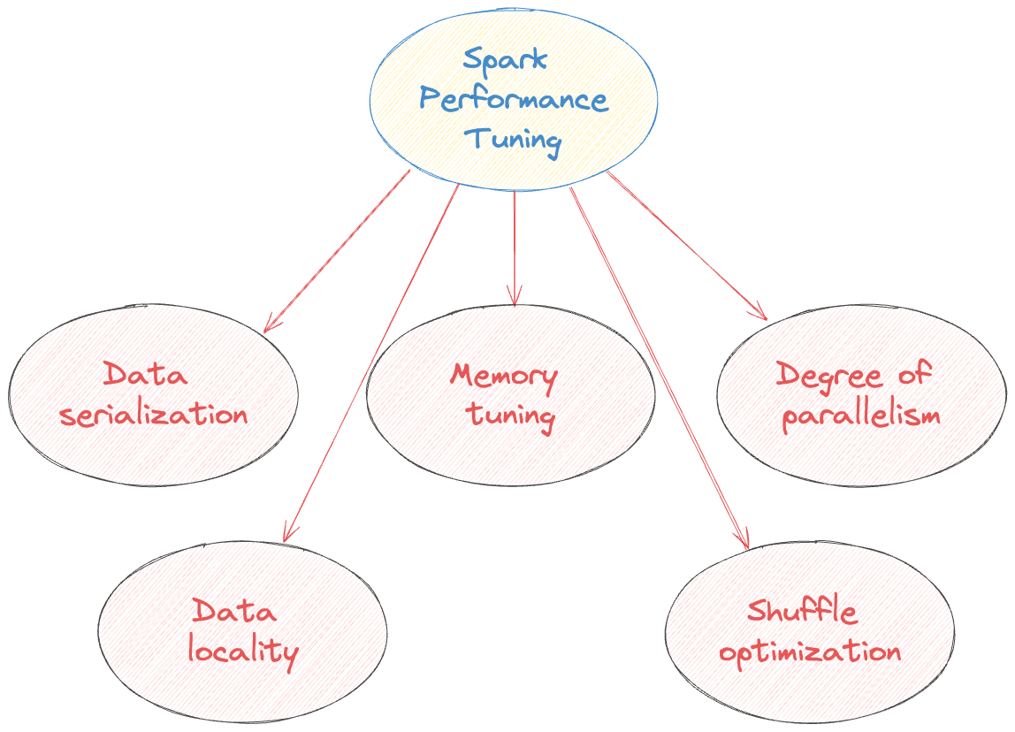
Spark Performance Tuning
Data serialization
Memory tuning
Degree of parallelism
Data locality
Shuffle optimization
DATATECH LABS.

Slide 20
Hands-on:
Deep Dive in Apache Spark/PySpark
DATATECH LABS.

Slide 21
Q&A and Discussion
DATATECH LABS.

Slide 22
Streaming Data Processing
DATATECH LABS.

Slide 23
Streaming Data Processing
DATATECH LABS.

Slide 24
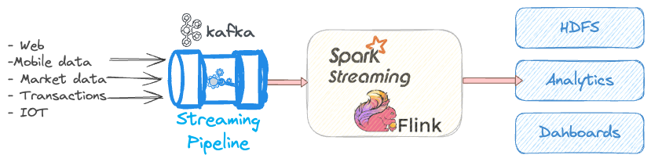
Introduction to Streaming Data Processing
Definition: Processing data in real-time as it arrives. It is the continuous flow of data as it's generated, enabling real-time processing and analysis for immediate insights.
Importance in modern data architectures:
Location data
Fraud detection
Real-time stock trades
Marketing, sales, and business analytics...
DATATECH LABS.

Slide 25
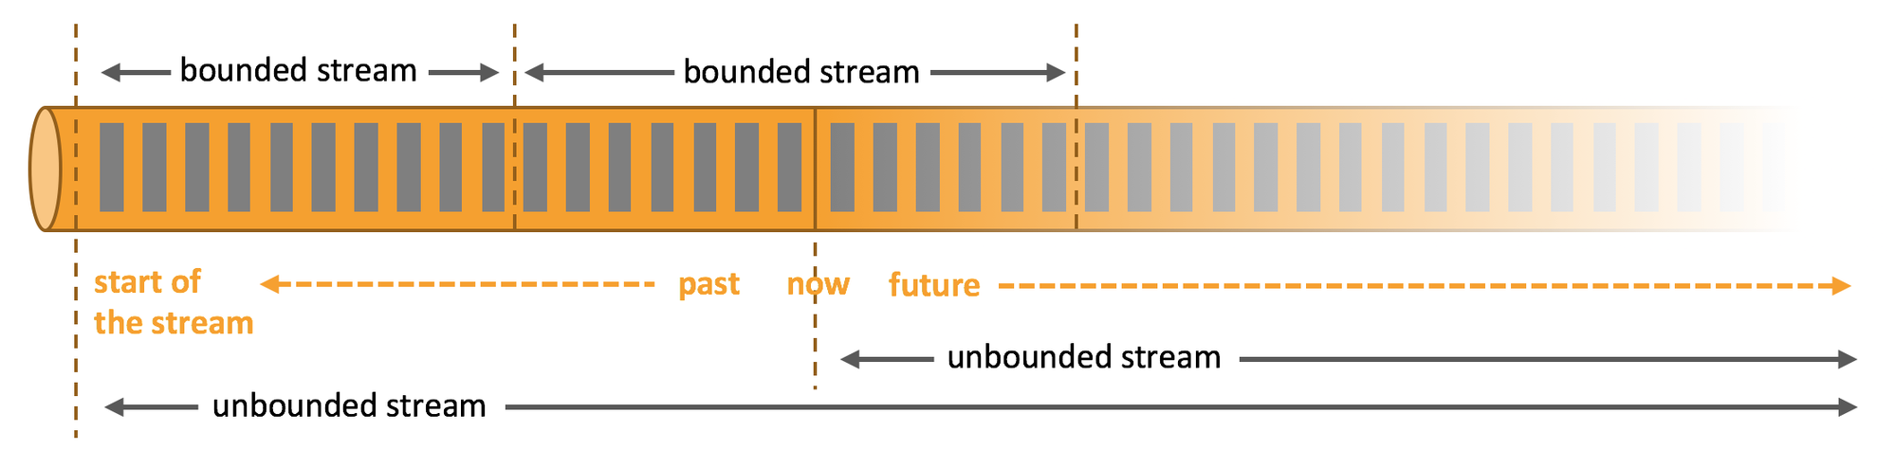
Characteristics of Streaming Data
Continuous
Unbounded
Time-sensitive
High volume and velocity
DATATECH LABS.

Slide 26
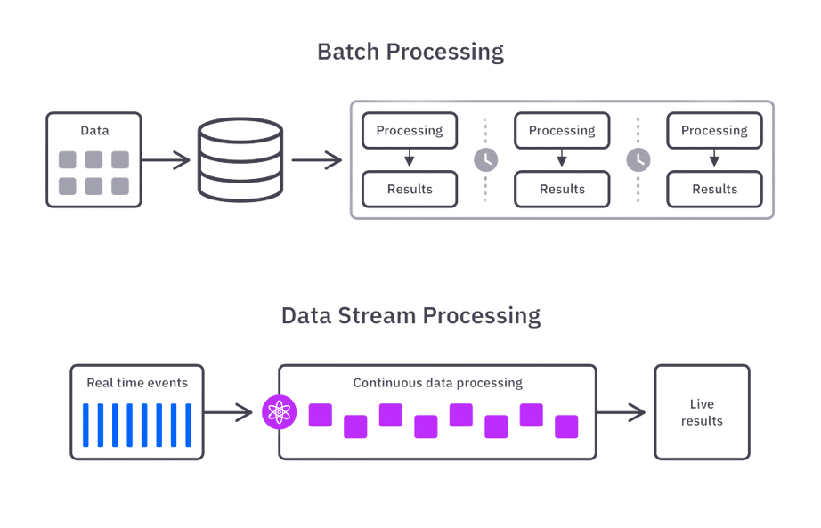
Streaming vs. Batch Processing
Aspect | Streaming | Batch
Data processing | Real-time | Periodic
Latency | Low | High
Throughput | Lower | Higher
Complexity | Higher | Lower
Use cases | Real-time analytics, monitoring | Historical analysis, reporting
DATATECH LABS.

Slide 27
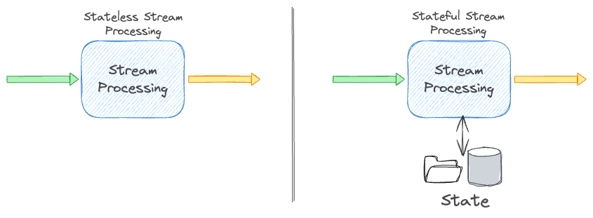
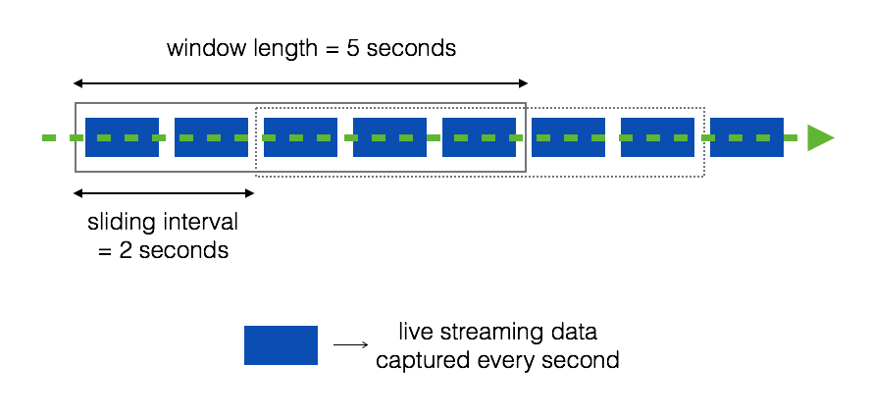
Streaming Data Processing Concepts
Event time vs. Processing time
Windowing: it allows data to be processed in small, manageable chunks over a specified period
Watermarks
State management
DATATECH LABS.

Slide 28
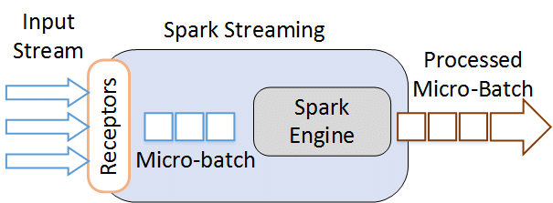

Streaming Processing Models & Data Sources
Processing Models
Record-at-a-time
Micro-batch
Hybrid
Data Sources
IoT devices
Social media feeds
Financial market data
Web clicks and user activity
Logs and metrics
DATATECH LABS.

Slide 29
Data Streaming
Tools
DATATECH LABS.

Slide 30

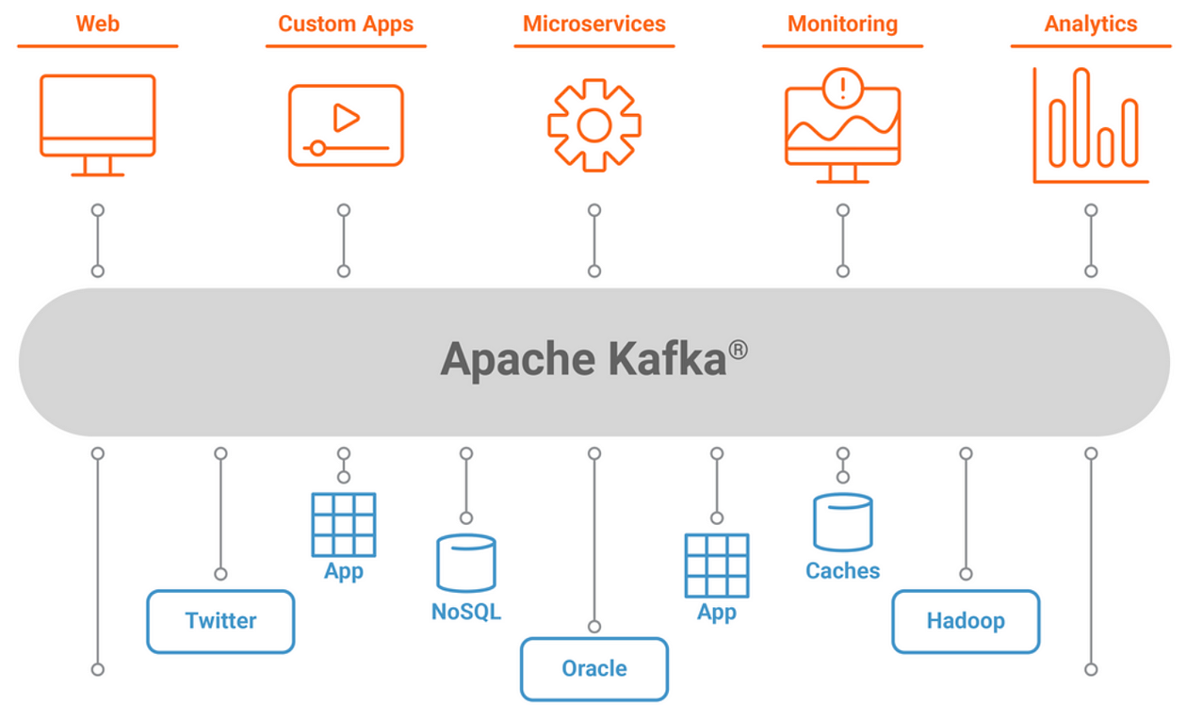
Introduction to Apache Kafka
Definition: Distributed messaging queue platform
Key features:
Publish-subscribe messaging
Fault-tolerant storage
Stream processing
DATATECH LABS.

Slide 31
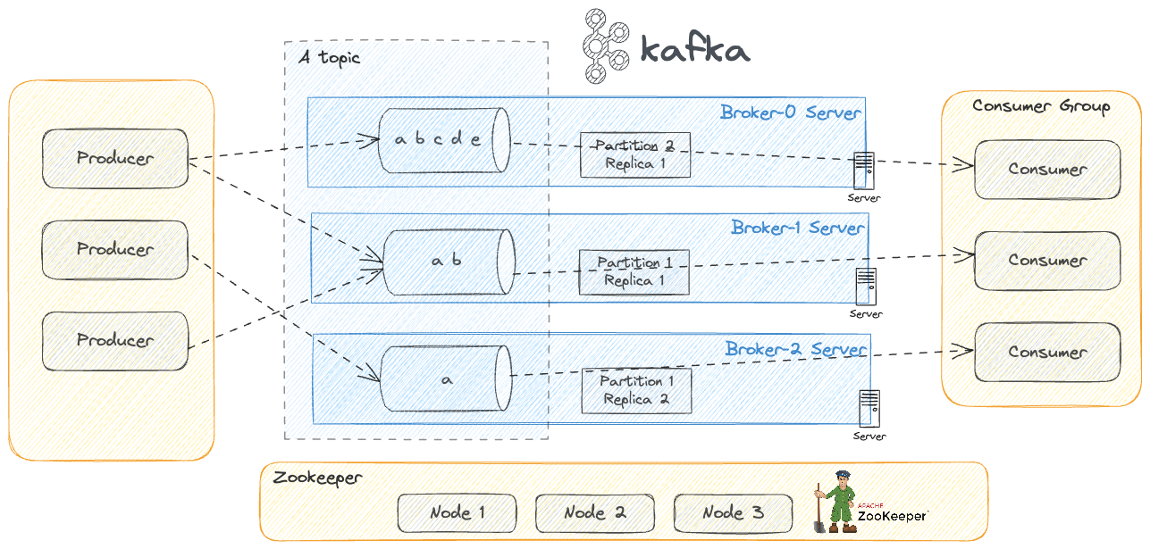
Kafka Architecture
Brokers
Topics and Partitions
Producers
Consumers and Consumer Groups
ZooKeeper
DATATECH LABS.

Slide 32
Kafka Topics and Partitions
Topics: Categories for organizing messages
Partitions: Units of parallelism within topics
DATATECH LABS.

Slide 33
Kafka Producers & Consumers
Kafka Producers:
Sending messages to topics
Partitioning strategies
Acknowledgment modes
Kafka Consumers
Subscribing to topics
Consumer groups for
scalability
Offset management
DATATECH LABS.

Slide 34
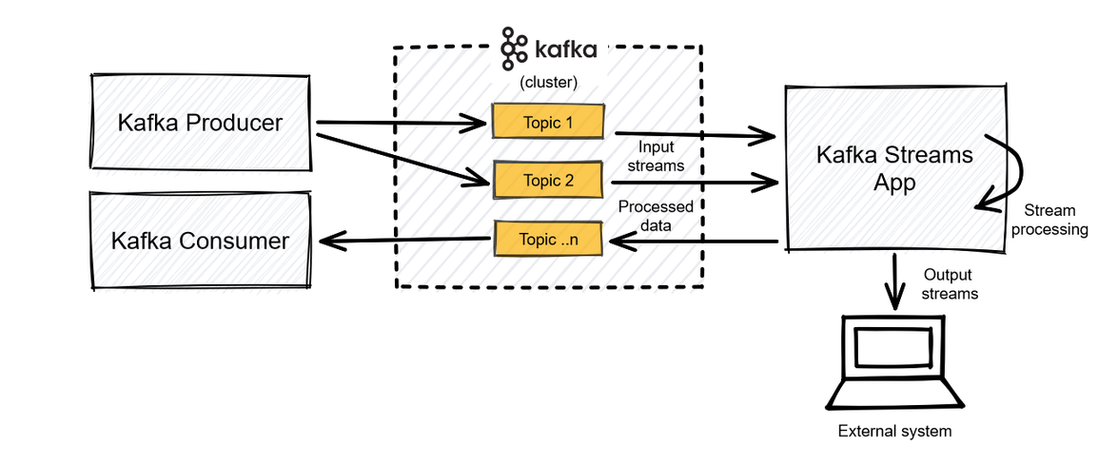
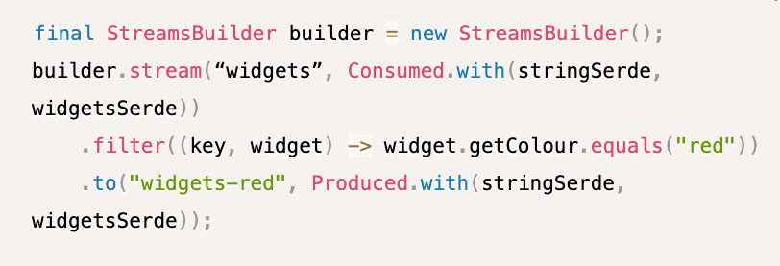
Kafka Streams
Lightweight library for stream processing
Stateful and stateless operations
Exactly-once semantics
DATATECH LABS.

Slide 35

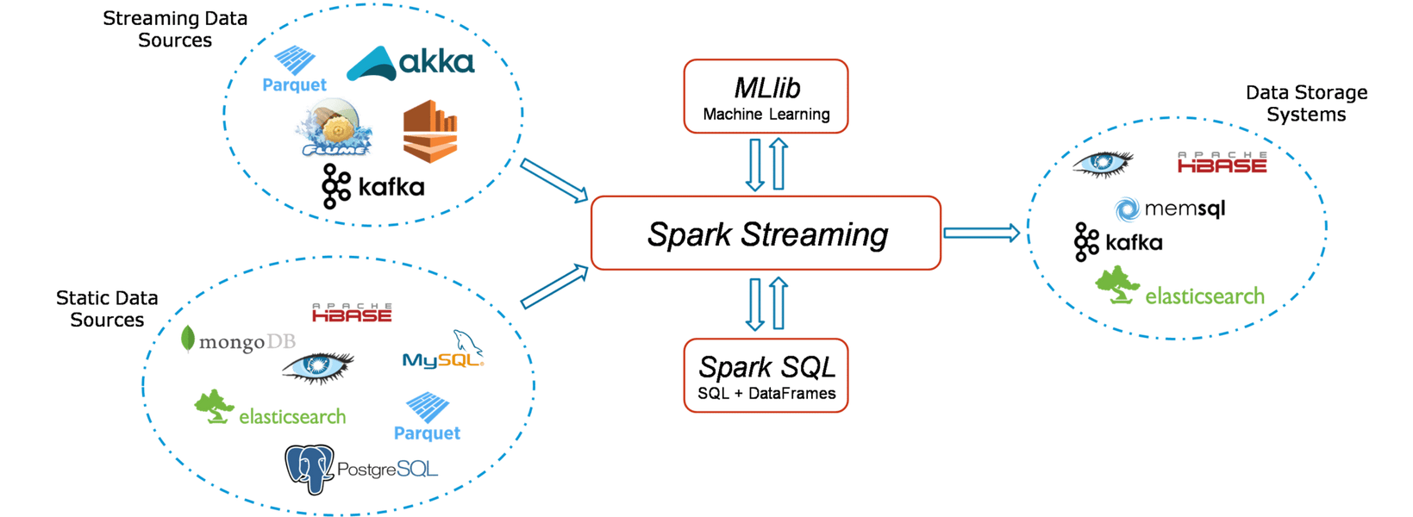
Spark Streaming
Definition: Extension of the core Spark API for processing live data streams
DStreams (Discretized Streams)
Input sources: Kafka, Flume, Kinesis, TCP sockets
DATATECH LABS.

Slide 36
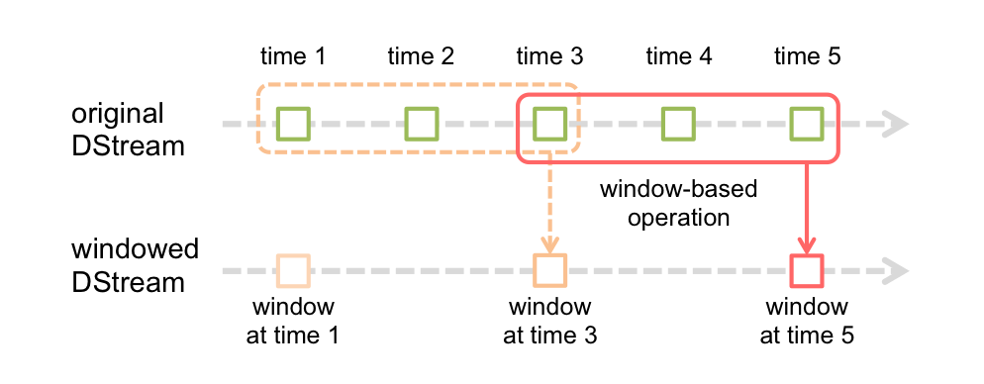
Spark Streaming Operations
Transformations on DStreams
Window operations
Join operations
Output operations
DATATECH LABS.
Notes:
https://spark.apache.org/docs/latest/streaming-programming-guide.html

Slide 37
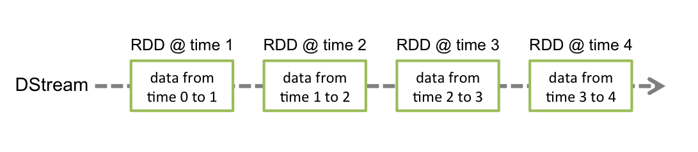
Structured Streaming
Definition: Scalable and fault-tolerant stream processing built on the Spark SQL engine
DStream is represented by a continuous series of RDDs
Advantages over DStreams:
Simpler programming model
Stronger consistency guarantees
DATATECH LABS.
Notes:
https://spark.apache.org/docs/latest/streaming-programming-guide.html#discretized-streams-dstreams

Slide 38
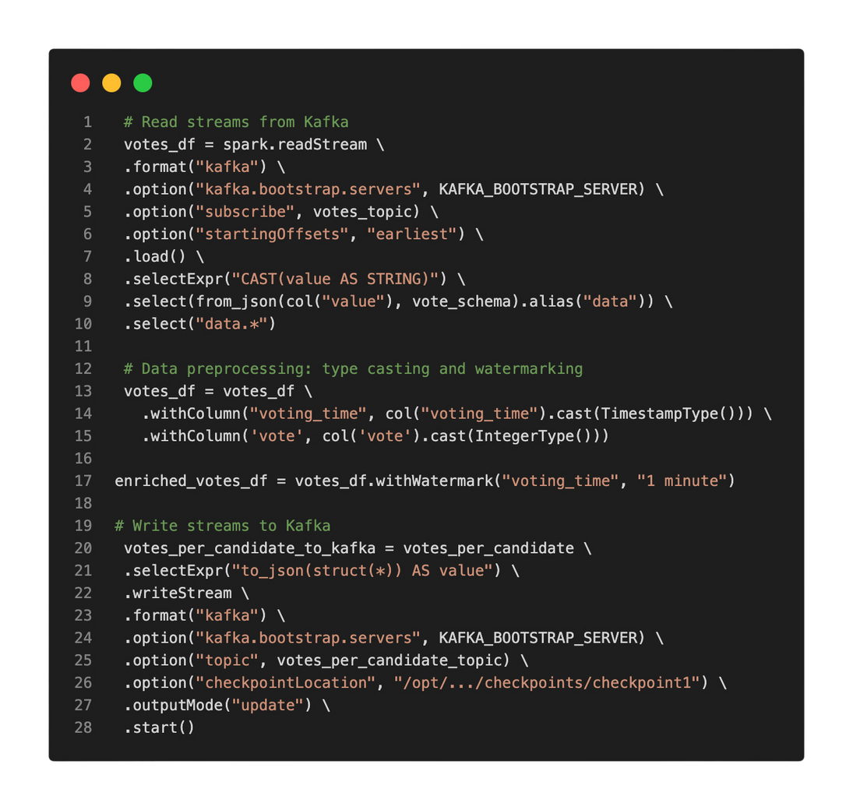
Structured Streaming Programming Model
Input sources
Operations and queries
Output sinks
Triggers and watermarking
DATATECH LABS.

Slide 39

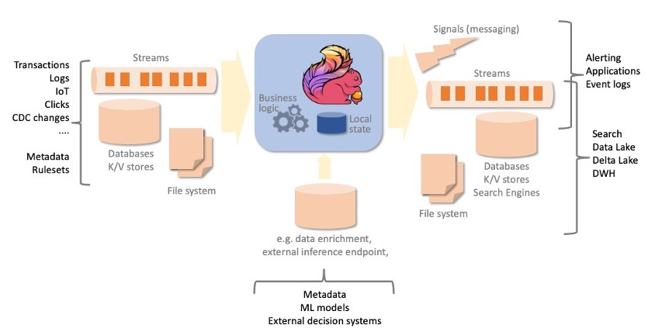
Introduction to Apache Flink
Definition: Distributed processing engine for stateful computations over data streams
Key features:
Event time processing
Stateful computations
Exactly-once semantics
DATATECH LABS.

Slide 40
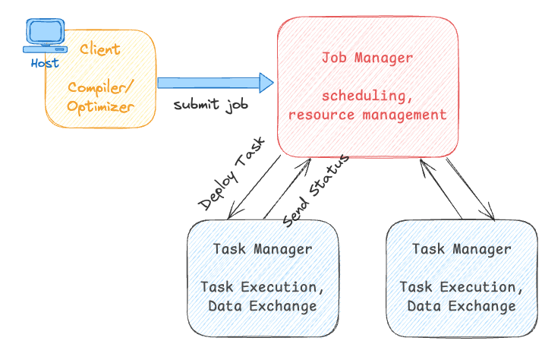
Flink Architecture
JobManager
TaskManagers
Client
DATATECH LABS.

Slide 41
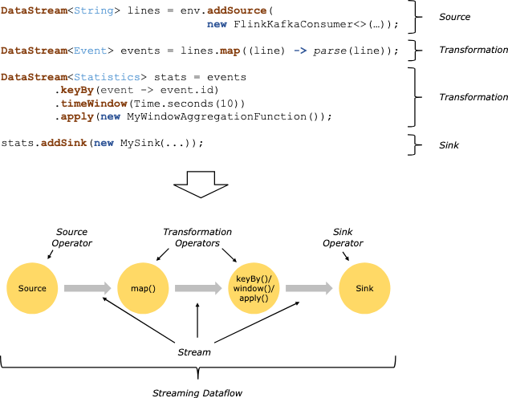
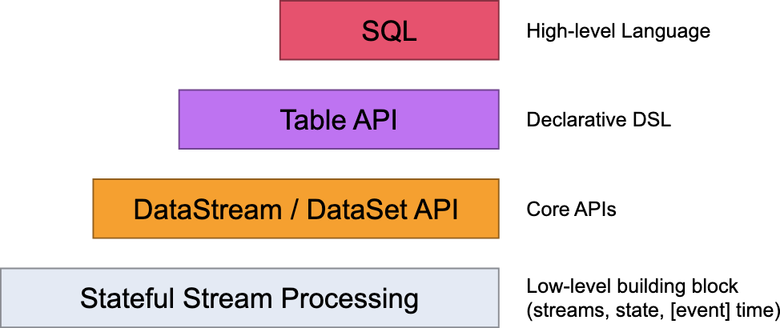
Flink Programming Model
Flink offers different levels of abstraction to develop streaming/batch applications:
DataStream API
Table API and SQL
ProcessFunction for low-level operations
DATATECH LABS.

Slide 42
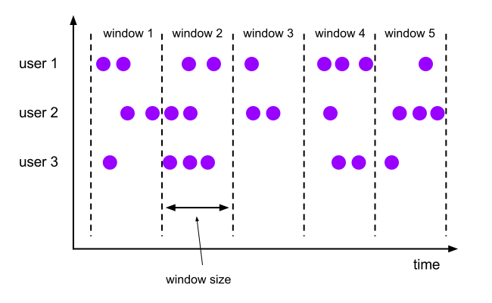
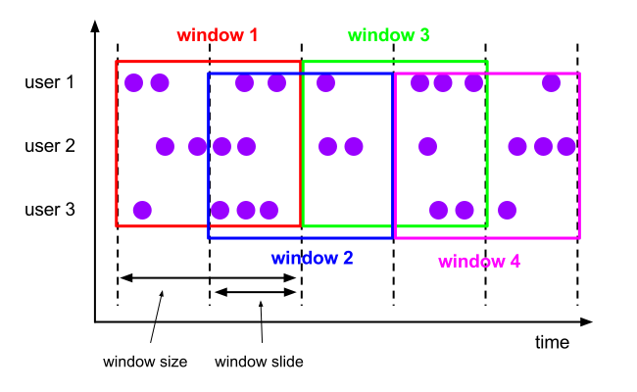

Flink Windows and Time
Types of windows:
Tumbling windows
Sliding windows
Session windows
Event time vs. Processing time
Tumbling windows
Sliding windows
Session windows
DATATECH LABS.

Slide 43
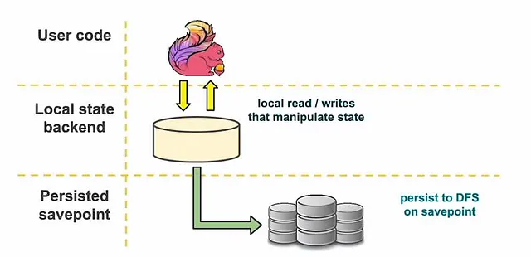
Flink State Management
Keyed state
Operator state
State backends (RocksDB, heap memory)
DATATECH LABS.

Slide 44
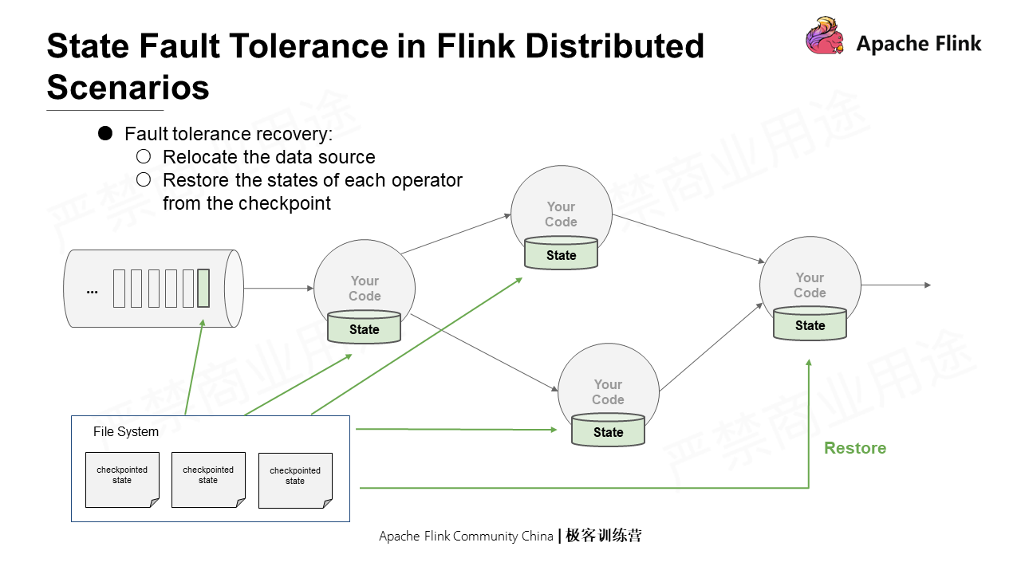
Flink Fault Tolerance
Fault tolerance means restoration to the states before the faults.
Checkpointing
Savepoints
Exactly-once guarantees
DATATECH LABS.

Slide 45
Comparison of Streaming Frameworks
Feature | Kafka Streams | Apache Flink | Spark Streaming
Type | Stream Processing Library | Stream Processing Framework | Stream Processing Framework
Latency | Low | Very Low | Low (Micro-batch)
Processing Model | Record-by-Record | Record-by-Record or Batch-like | Micro-batch
State Management | RocksDB, in-memory | RocksDB, in-memory, custom | In-memory, HDFS
Fault Tolerance | Log-based storage | Checkpointing, Savepoints | Checkpointing
Scaling | Limited by Kafka Cluster | Dynamic scaling | Cluster-based scaling
Use Cases | Real-time analytics, ETL | Complex event processing, ETL | Real-time analytics, ETL, batch
Ease of Use | Simple, requires Kafka knowledge | Flexible but more complex | Moderate, requires Spark knowledge
DATATECH LABS.

Slide 46

Best Practices for Streaming Data Processing
Handling late and out-of-order data
Scaling and performance tuning
Monitoring and alerting
Data quality and validation in streams
DATATECH LABS.

Slide 47
Hands-on:
Data Streaming Pipelines.
DATATECH LABS.

Slide 48
Q&A and Discussion
DATATECH LABS.

Slide 49

MEET OUR TEAM
Omar AlSaghier
Sr. Data Engineer
DATATECH LABS.

Slide 50







DATATECH LABS.
THANK YOU
OUR CONTACT
DataTechLabs
datatechlabs.ai@gmail.com
datatechlabs.ai
Amman, Jordan

